Slide 1
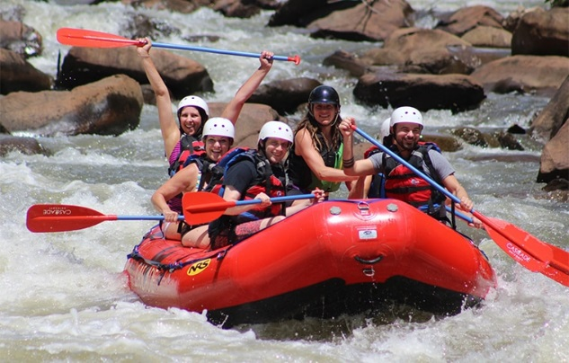
Tennessee Valley Chapter
Army Aviation Association of America
Invites our Members and Guests
White Water Day Trip
30 June 2018
2:00 – 5:30 PM
Cascade Outdoors
1248 Highway 64
Ocoee, TN 37361
Please contact Tony.White@vencore.com
Or Greg.Oelberg@vencore.com
If you are interested in participating
Discounted cost of $20/person for members
and new members

