Slide 1
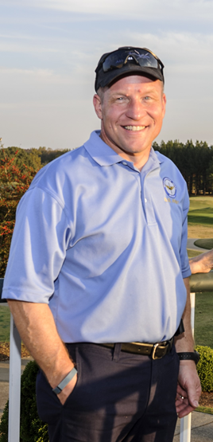
You are invited to the 2022
COL Hoecherl Memorial AAAA
Scholarship Golf Scramble
SAVE THE DATE!
When: 12 July 2022
Where: Robert Trent Jones Golf Course
(located at 450 Old Highway 431, Owens Crossroads)
Registration begins at 0700
Shotgun start at 0800
Come enjoy a day of Team Building while raising scholarship funds in honor of a great American
Sponsorships for Breakfast and Lunch as
will as Hole Sponsorships will be available
POCs: Mr. Robin Cofer, 256-642-6927 or email: robin.d.cofer.ctr@mail.mil
Ms. Jennifer Hare, 256-783-6435, jennifer.m.hare2.civ@mail.mil
Ms. Shannon Murphy, 256-361-3371, shannon.l.murphy39.ctr@army.mil
Mulligans will be sold at the check in desk 2/$10
All proceeds will be donated to the AAAA Scholarship named for COL Hoecherl.
AAAA Scholarship Foundation:
It is exempt from Federal income tax under Section 501(c)(3) of the Internal Revenue Code. Contributions by donors are deductible as provided in Section 170 of the Code. A donation acknowledgement is mailed to each donor. The AAAA Scholarship Foundation's Federal Tax ID number is 06-0799487.

Slide 2
Sponsorship
Opportunities
Hole Sponsor - $800
Includes a four person team and your Company’s logo on a hole sign, and event banner
Breakfast Sponsorship - $1400
Includes a four person team, your Company’s logo on
the event banner and Sponsorship banner in the breakfast
area. (looking for two sponsors at this level)
Lunch Sponsorship - $1800
Includes a four person team, your Company’s logo on
the event banner and Sponsorship banner in the lunch
area. (looking for two sponsors at this level)
Other Support
SWAG is always welcome! We anticipate a full tournament with a total for both days of 130 participants!
*Please submit your highest resolution Company logo to Shannon Murphy at shannon.l.murphy39.ctr@army.mil

Slide 3
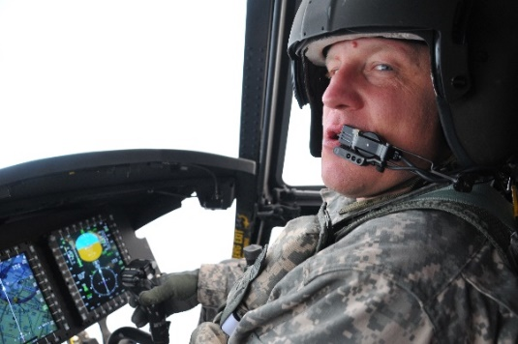
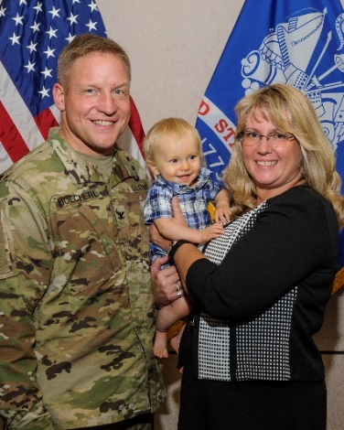
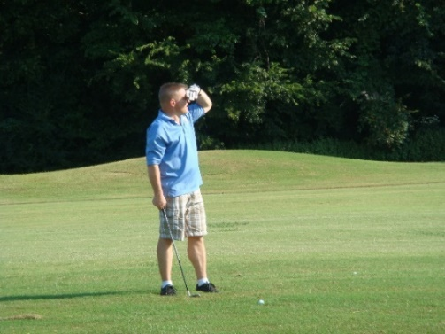
COL Joseph “Joe” Hoecherl
1967 - 2018
COL Joe Hoecherl enlisted in the Army Reserve at 17, beginning his life-long military career. He transferred to active duty in 1986, and served as an enlisted Soldier for five years before training to become an Army helicopter pilot – qualified in the UH-1, OH-58A/C, CH-47D/F and AH-64D.
In 2016, he took over as the Apache Project Manager at the Program Executive Office for Aviation. During this time, in April 2017, he was diagnosed with Stage IV cancer. He continued to work full-time while fighting cancer until January 2018, when his cancer battle required much more of his time and energy. COL Hoecherl passed away on May 2, 2018, at age 51. He was laid to rest with full military honors at the Alabama National Cemetery in Montevallo, Alabama.
A follower of Christ to the end, Hoecherl was a servant leader with a strong work ethic and a listening ear. He served his family, friends, and all those he led and worked with and for in his Army career with a generous and kind heart and a strong moral compass. He made a lasting impact on the many lives he touched with his positive attitude, kindness, compassion and faith. He was a devoted and loving husband, father and grandfather, and he will be forever loved by those he left behind.
In honor of his memory, the Apache Project Office worked with the Tennessee Valley Chapter of AAAA to establish a Scholarship in his name.

