Slide 1
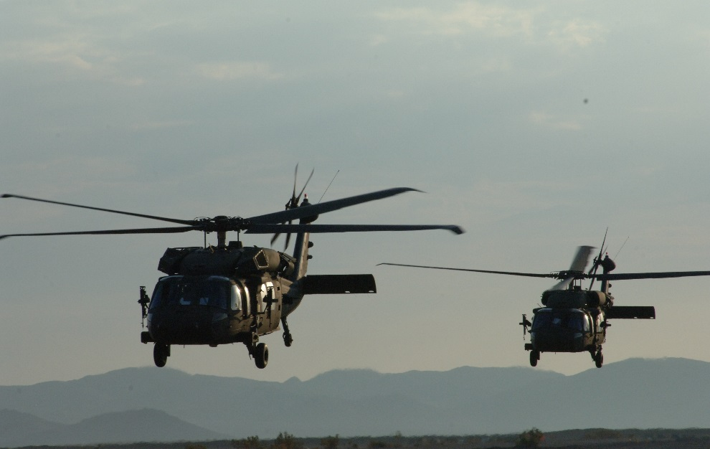
Tennessee Valley Chapter
Army Aviation Association of America
Invites our Members and Guests
Utility PM Update and Presentation
of the 2018 Quarterly Mission Area Awards
19 June 2018
4:00 – 6:30 PM
Rocket City Tavern
2100 Rideout Road SW
Huntsville, AL 358058
Please contact Greg.Oelberg@vencore.com
If you would like to help sponsor this event

