Slide 1
AAAA AWARDS
April 28, 2016
Awards Chairman: MG Walter L. Davis, Ret.
Awards Manager: Janis Arena

Slide 2
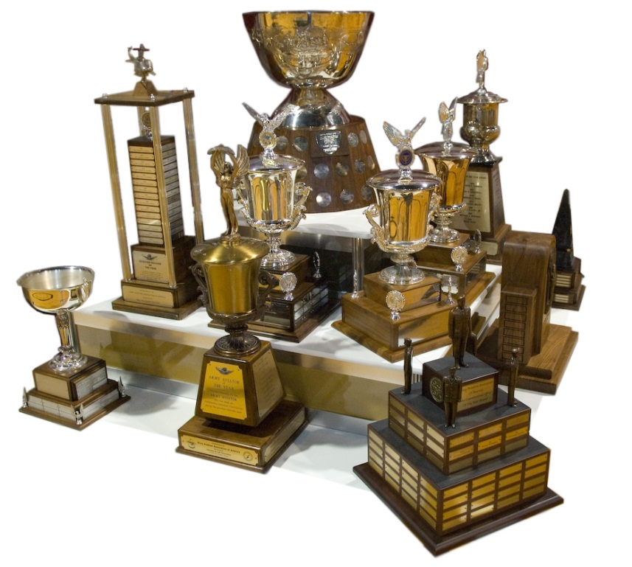
MANY DIFFERENT AWARDS
National Awards
Functional Awards
Army Aviation Hall of Fame
Chapter Awards
Order of St. Michael Awards
Our Lady of Loreto Award
Distinguished Graduate Awards
USMA Cadet of the Year
ROTC Cadet of the Year

Slide 3
GLOBAL VIEW
We need you to submit nominations!
National Awards are pretty good
Functional Awards are very light
Hall of Fame nominations need to include more contemporary soldiers

Slide 4
NATIONAL AWARDS
Presented During Annual Summit and
Address the Aviation Community at Large
INDIVIDUAL AWARDS
DAC of the Year
Safety Award
Crew Chief of the Year
Soldier of the Year
NCO of the Year
Aviator of the Year
UNIT AWARDS
Robert M. Leich Award
USAR Unit of the Year
ARNG Unit of the Year
Active Unit of the Year
Outstanding Unit of the Year

Slide 5
Address areas of specialty and Presented During Forum Events
FUNCTIONAL AWARDS
AAAA ASE Forum
AMSO Award
ASE Award
Avionics Award
Tennessee Valley Cribbins Symposium
Logistics Unit of the
Fixed Wing Unit of Year
UAS Soldier of the Year
UAS Unit of the Year
Depot Maintenance Artisan
Materiel Readiness Awards
Contribution by an Individual
Contribution by a Team or Group
Contribution by a Small Business
Contribution by Major Contractor
Ft. Rucker Sr. Leader’s
Air/Sea Rescue
ATC Facility of the Year
ATC Unit of the Year
ATC Technician of the Year
ATC Controller of the Year
ATC Manager of the Year
DUSTOFF Medic of Year
Medicine Award
Trainer of the Year

Slide 6
ARMY AVIATION HALL OF FAME
Need nominations from Global War of Terror
Active duty Colonel or above are NOT eligible
All enlisted and Warrant Officers are eligible
Deadline is June 1st of each year

Slide 7
Awards at the Chapter Level
Monthly Awards – FREE * Soldier of the Month
* NCO of the Month
Quarterly Awards – FREE * Soldier of the Quarter
* NCO of the Quarter
Yearly Awards – FREE * Soldier of the Year
* NCO of the Year
Chapter Sponsored Soldier to Attend Summit
(Underwritten in part by AAAA)
Bronze OSMs and Lady of Loreto

Slide 8
How To Submit Hall Of Fame
And Award Nominations
Nomination Forms available on AAAA website: www.quad-a.og
Nomination packets need to include:
Completed nomination form
250 word Summary Document
1500 word Support Document
Individual’s Bio (CO and Sr. NCO for Unit Awards)
Individual’s Photo (CO and Sr. NCO for Unit Awards)
No additional information included in packet
Summary, Support and Bio submitted in MS “WORD ” Format
Nominations must arrive AAAA HQ by deadline

Slide 9
Order of Saint Michael Awards
ARMY AVIATION RECIPIENTS
Bronze OSM – Approved at Chapter Level
Silver OSM – Approved at National Level
Gold OSM – Approved at National Level
NON ARMY AVIATION RECIPIENTS
Knight OSM – Approved at National Level
Our Lady of Loreto – Approved at Chapter Level

Slide 10
OTHER AAAA AWARDS
President’s Award
Family Support Award
Art & Dotty Kesten Founder’s Award
West Point Cadet of the Year
ROTC Cadet of the Year
Distinguished Graduate Awards
Fort Rucker (Entry Rotor Wing Courses)
Fort Huachuca (UAS Training Courses)
Ft. Eustis, 128th Avn. Bde. (Enlisted Training Courses)
Eastern Army Aviation Training Site
Western Army Aviation Training Site

Slide 11
AAAA POCs For Award Questions
(203) 268-2450 or (800) 722-2769
Janis Arena or Corey Stokes
National Awards
Functional Awards
Hall of Fame
Deb Cavallaro
OSMs, Knight Award and Lady of Loreto
Soldier and NCO of Month, Quarter and Year
Barb McCann
Chapter Sponsored Soldier to Attend Annual Summit

