Slide 1
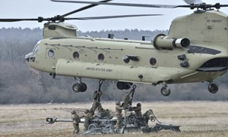
Tennessee Valley Chapter Army Aviation Association of America Invites our Members and Guests to the PM Cargo Update and Quarterly Mission Area Awards Presentation
22 March 2023
3:30 – 5:30 PM
Rocket City Tavern
2100 Rideout Road
Redstone Arsenal, AL 35898
Please contact at Greg.Oelberg@peraton.com or
256-964-1346 if you would like to help sponsor this event

